Slide 1
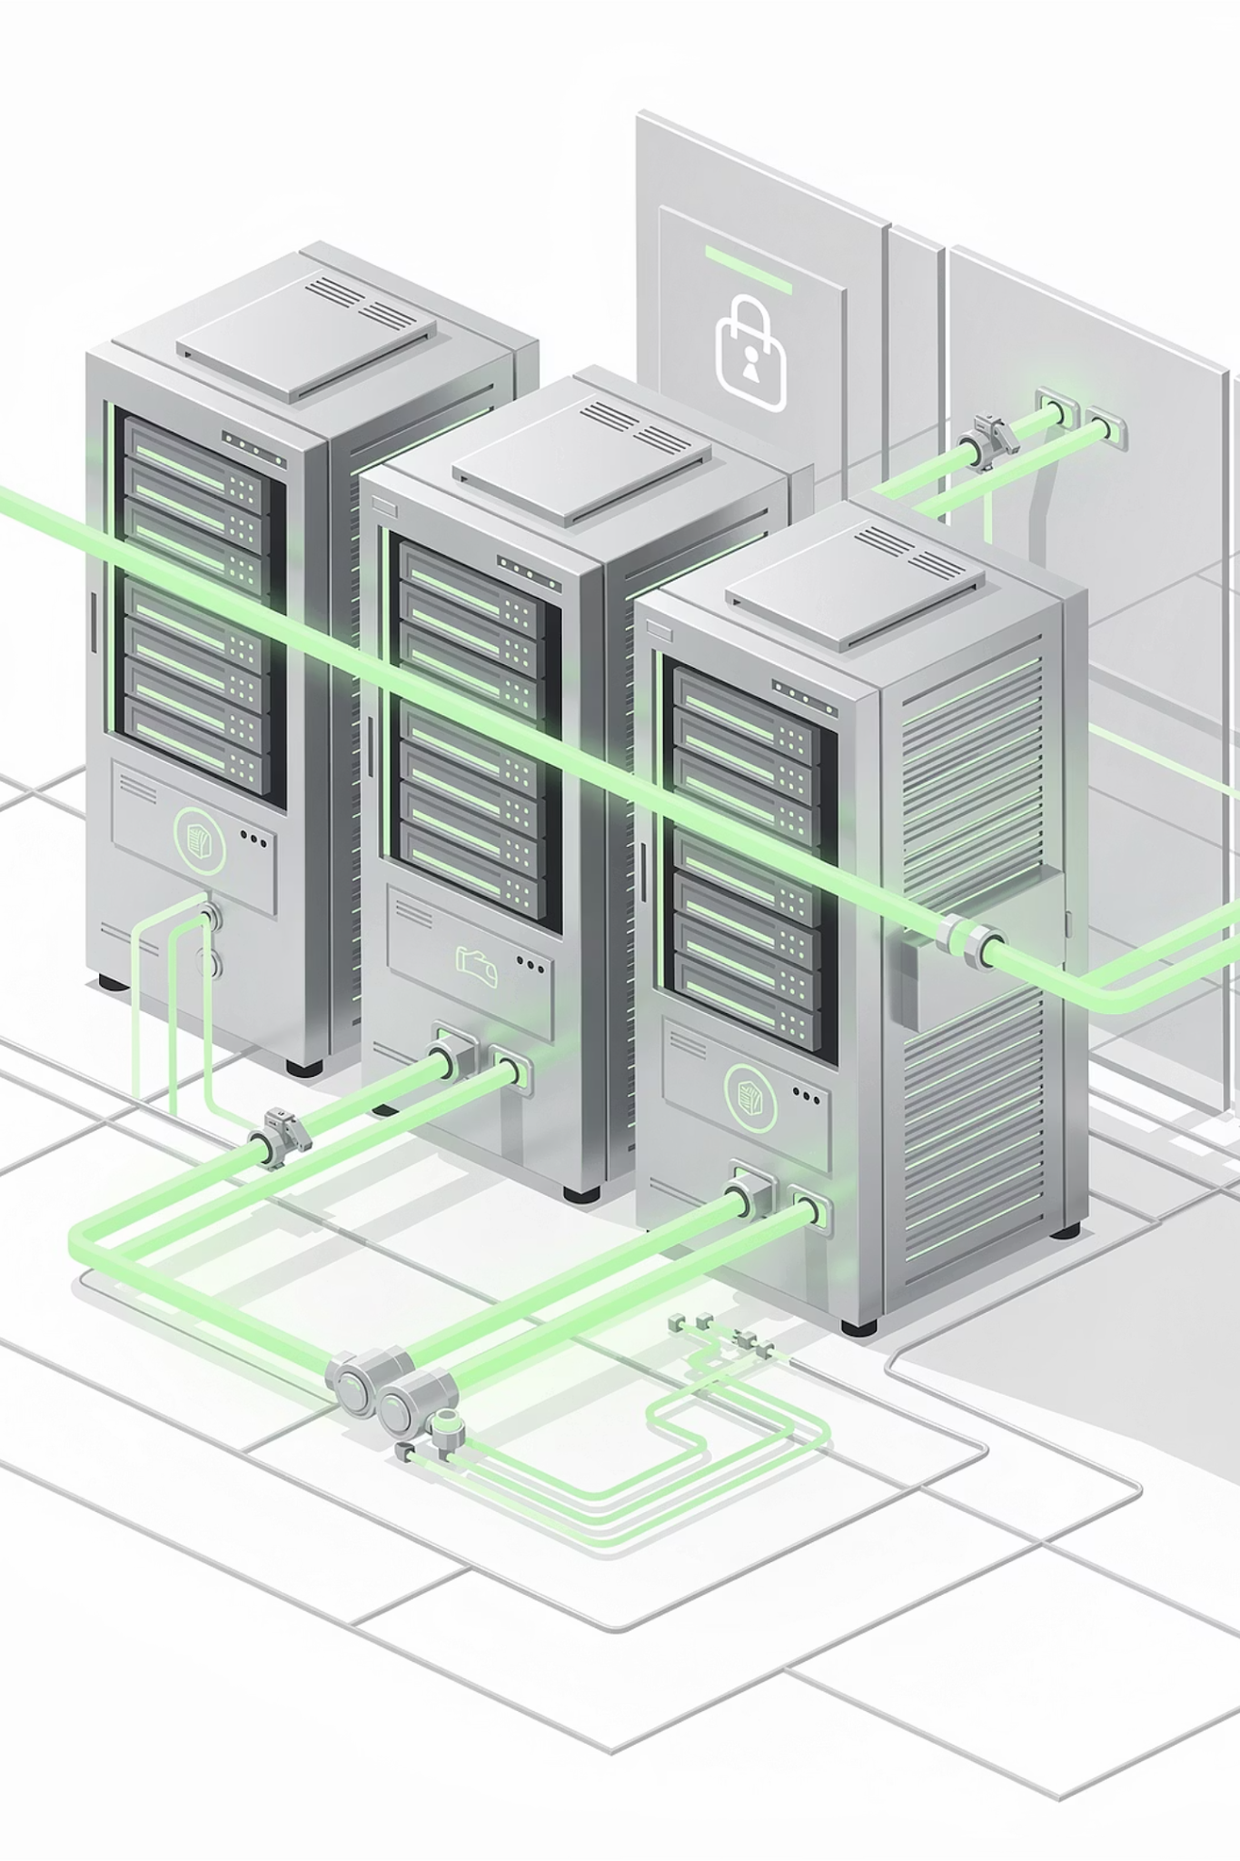

Automation & CI/CD Thinking
Understanding Modern Software Delivery
1

Slide 2
Session Agenda
01
02
SDLC Overview
What is Automation?
03
04
CI vs CD
Manual vs Automated Deployment
05
06
Real-World Release Examples
CI/CD Pipeline Diagram
07
08
Failure & Recovery Scenarios
Pipeline Design Discussion
2

Slide 3
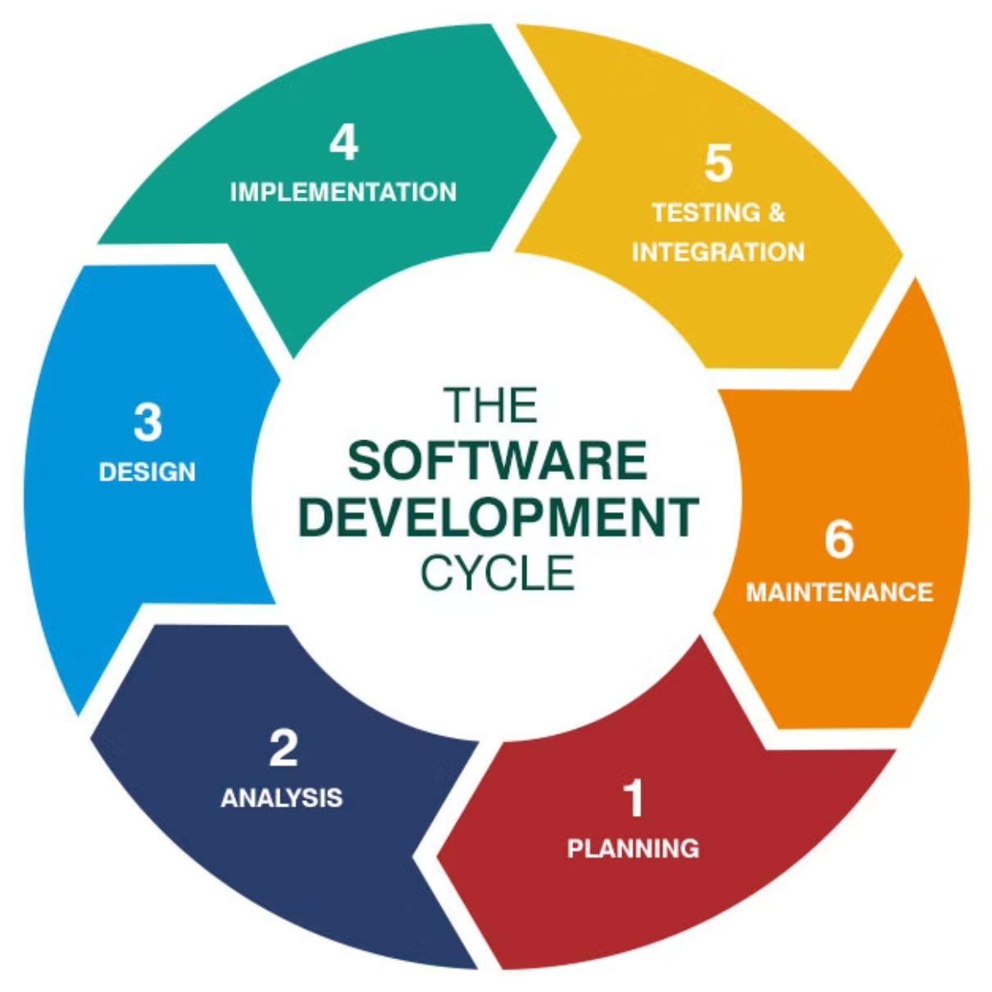
CONCEPT INTRODUCTION
What is SDLC?
SDLC = Software Development Life Cycle — a systematic approach to delivering reliable software.
Each stage builds on the last, ensuring quality and predictability throughout the software lifecycle.
3

Slide 4

Traditional vs Modern SDLC
Traditional
Long release cycles
Manual testing
Manual deployment
Modern
Frequent releases
Automated testing
Continuous integration
Modern development needs automation.
4

Slide 5
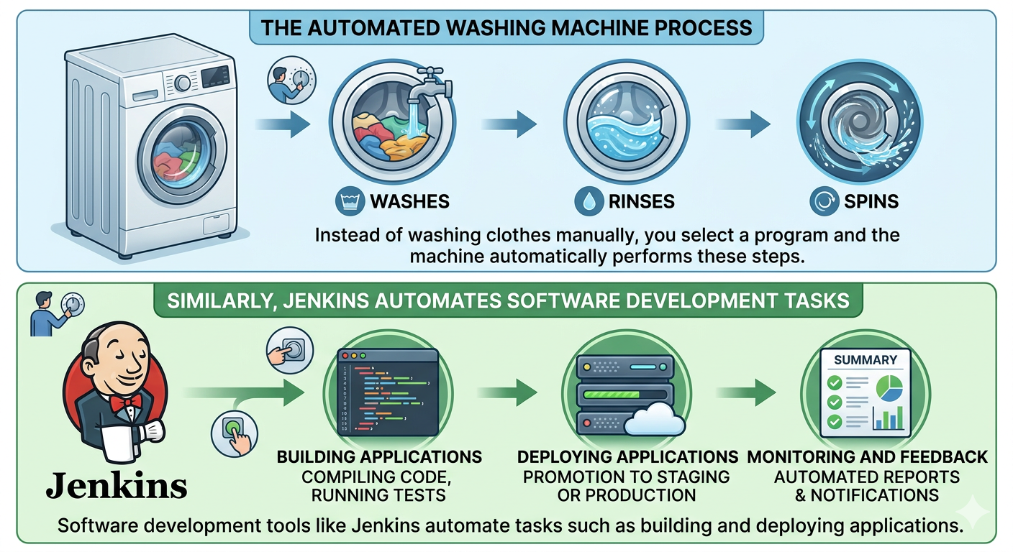




AUTOMATION DEFINED
What is Automation
Using tools and scripts to perform tasks automatically without manual intervention.
Example: Think about a washing machine.
Speed
Consistency
Fewer Errors
Automated Testing
Automated Builds
Auto-Scaling
Auto-Deployment
5

Slide 6


Why Automation Matters
Without Automation
Human mistakes
Slow releases
Inconsistent environments
With Automation
Faster delivery
Reliable deployments
Repeatable process
Automation = Foundation of DevOps.
6

Slide 7
Quiz Time
Q1. A developer must run the same test commands every day before releasing code. What is a better approach instead of doing this manually?
✅ Answer: Automate the testing process using CI tools so tests run automatically after code changes. Tools like Jenkins can run automated builds and tests.
Q2. A company releases new software updates only once every 6 months.
What problem might this cause?
✅ Answer: Bugs may remain unfixed for a long time and users must wait longer for new features. Modern teams use automation and CI practices to release updates more frequently.
Q3. A team performs the same deployment steps for every release.
What DevOps mindset should they adopt?
✅ Answer: If a task is repeated often, it should be automated to save time and reduce errors.
7

Slide 8
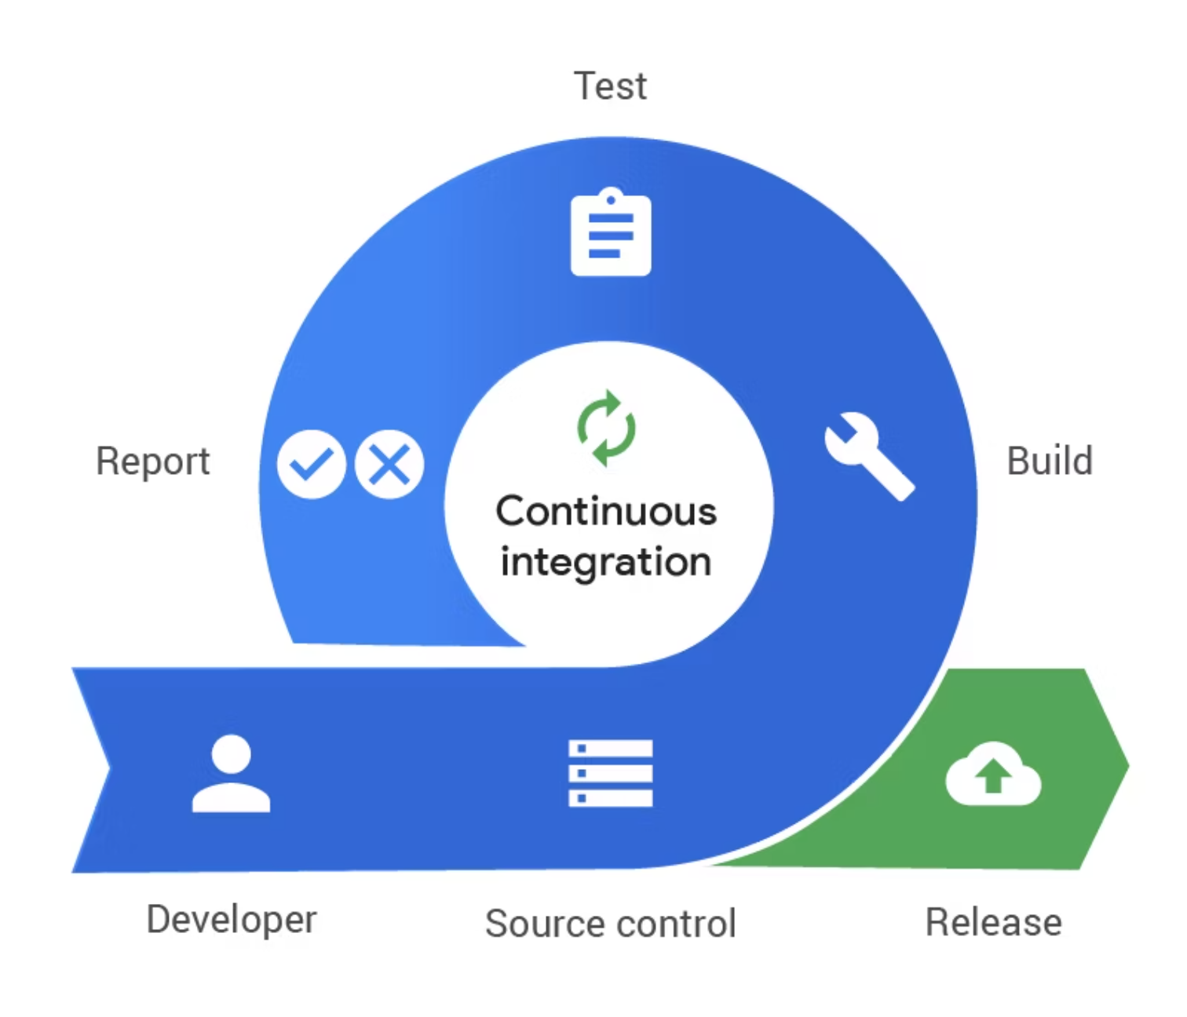


CI VS CD
What is CI?
Continuous Integration
Developers frequently merge code
Automated build runs on every merge
Automated tests run immediately
Goal: Detect issues early.
Example Tools:
Jenkins
GitHub Actions
8

Slide 9
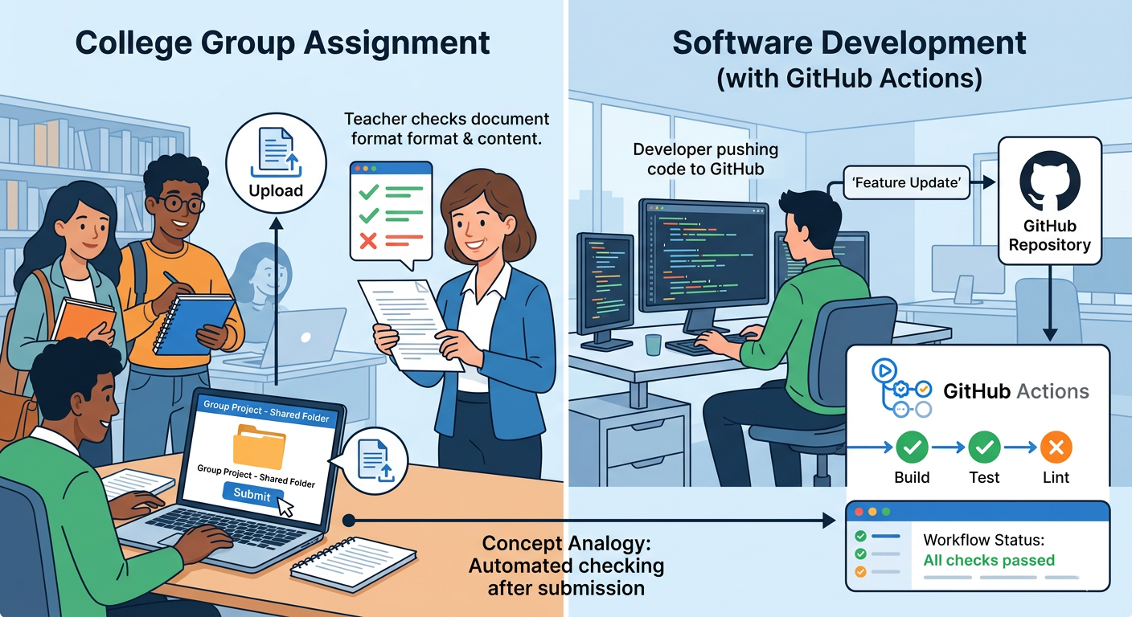
CI VS CD
Example of CI
Imagine a group assignment in college.
Each student submits their part of the assignment to a shared folder.
The teacher immediately checks if the document format and content are correct.
In software development, tools like GitHub Actions automatically check the code after developers upload it to GitHub.
9

Slide 10
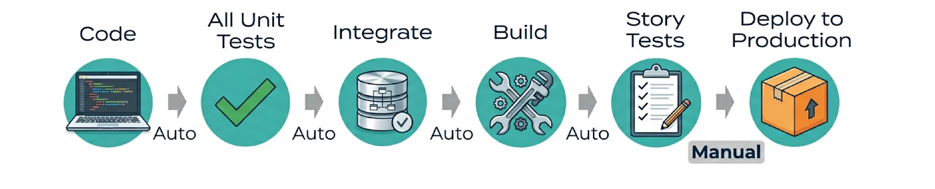
What is CD?
Continuous Delivery
Continuous Deployment
Code is always ready for release — but requires manual approval before going to production.
Code automatically goes to production after all tests pass — fully automated release.
Delivery → Manual approval | Deployment → Fully automated
10

Slide 11
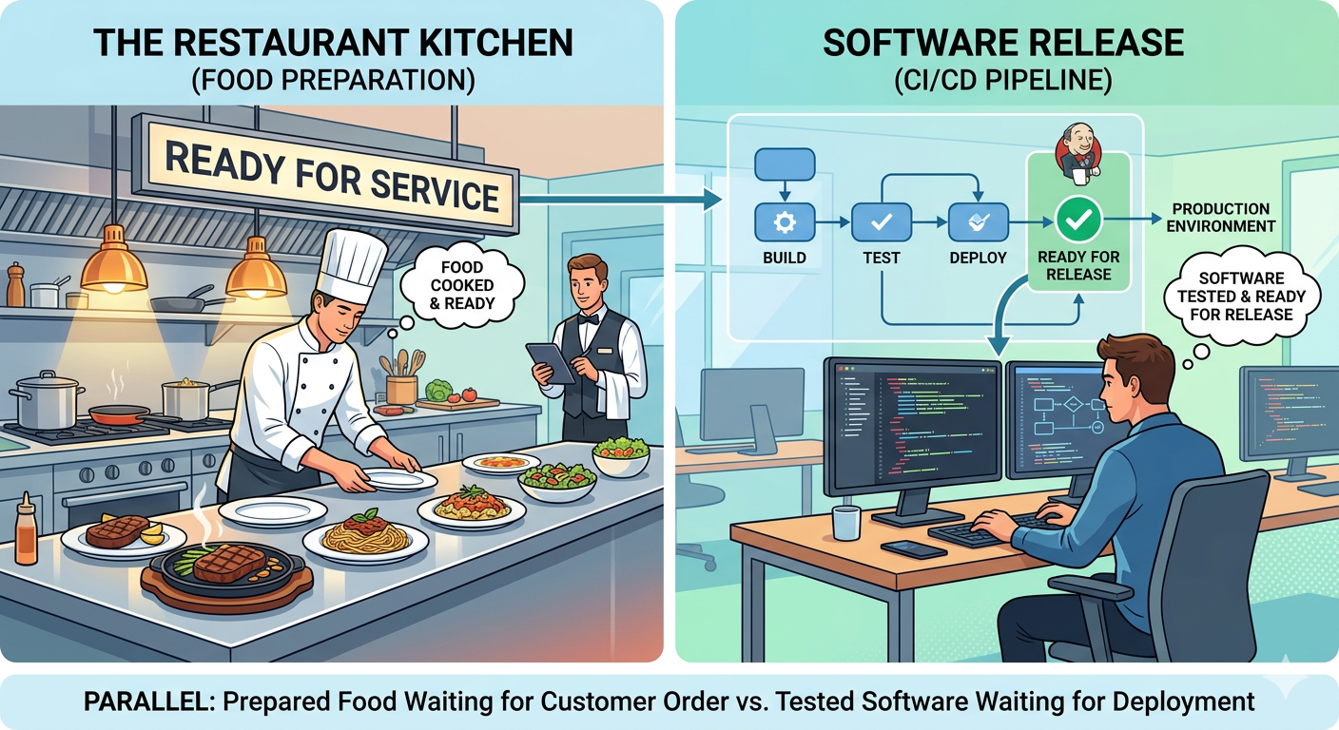
CI VS CD
Example of CD
Think of a restaurant kitchen preparing food.
The food is cooked and kept ready.
When the customer confirms the order, the food is served immediately.
Similarly, after testing, software is kept ready for release using CI/CD tools like Jenkins.
11

Slide 12
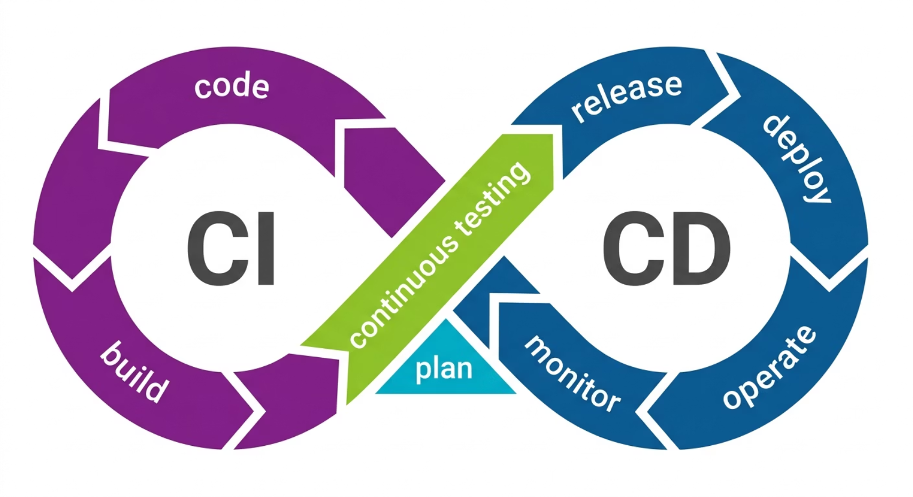
CI vs CD Summary
CI
CD
Integrate code frequently
Deliver code automatically
Run automated tests
Deploy automatically
Detect issues early
Faster releases
CI ensures quality. CD ensures speed.
12

Slide 13
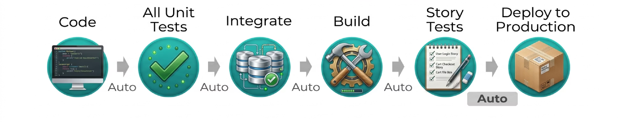
MANUAL VS AUTOMATED DEPLOYMENT
Manual vs Automated Deployment
Manual Deployment
Automated Deployment
Copy files to server manually
Restart services manually
Run database updates manually
Code pushed to repo
Pipeline triggered automatically
Build → Test → Deploy
⚠️ Time-consuming, error-prone, inconsistent
✅ Reliable, fast, repeatable, less stress
13

Slide 14
Quiz Time
Q1. A developer pushes new code, and the system automatically builds and tests it. Which practice does this represent?
✅ Answer: Continuous Integration (CI). CI tools such as GitHub Actions automatically run builds and tests.
Q2. After tests pass, the application is automatically deployed to production without manual approval. What is this called?
✅ Answer: Continuous Deployment.
Q3. Why do teams run automated tests immediately after code changes?
✅ Answer: To detect problems early before the code reaches production.
14

Slide 15

REAL-WORLD EXAMPLES
App Update Cycle
New Feature Release Flow
1
Developer pushes code
2
CI runs tests & builds
3
Deploy to staging
4
Approved → Production
Users receive updates seamlessly.
15

Slide 16





Production Bug Hotfix
Fix Branch Created
Quick Commit
Pipeline Runs
Deploy Immediately
Without CI/CD: Manual patching — risky and slow.
16

Slide 17
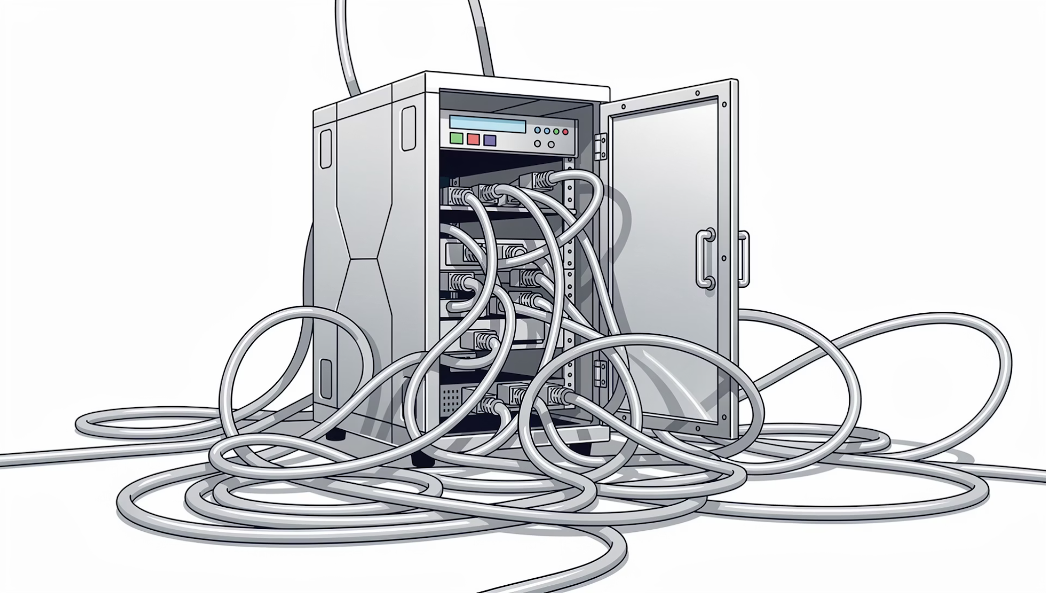

Release Management Problems
Without CI/CD
Broken Builds
Unstable code reaches production
Environment Mismatch
"Works on my machine" syndrome
Manual Rollback
Risky and time-consuming recovery
CI/CD solves all of these issues.
17

Slide 18
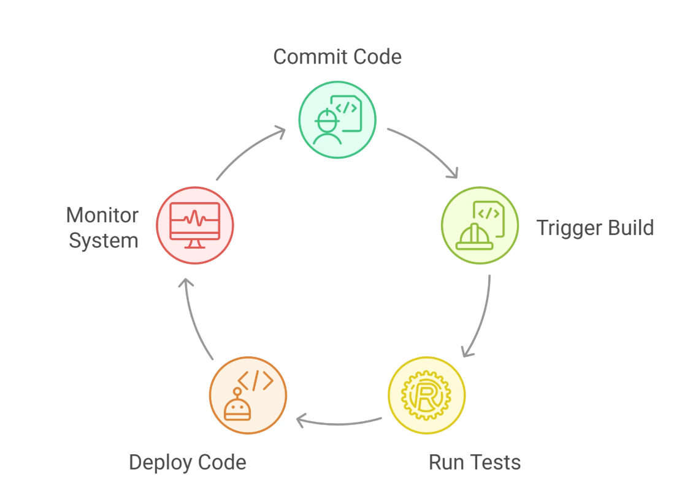
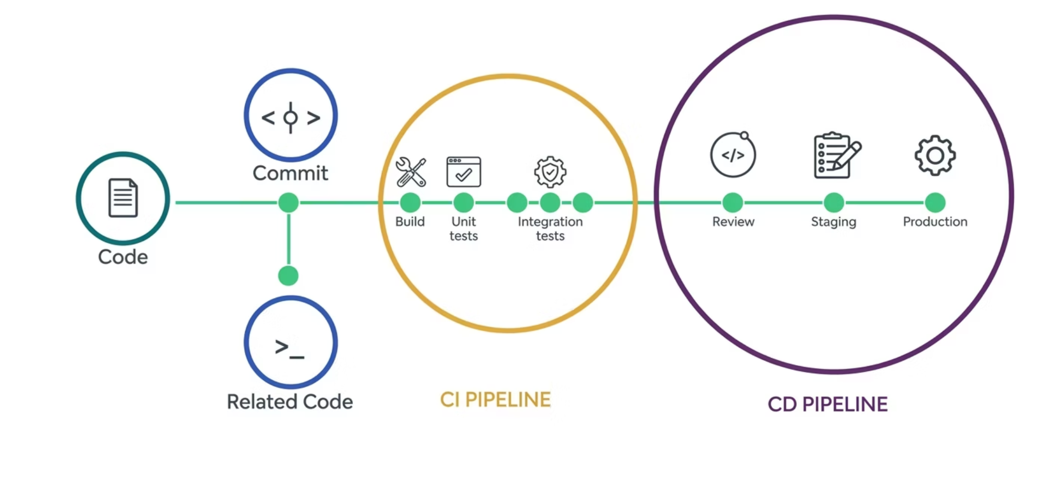
DEMO / DIAGRAM
Basic CI/CD Pipeline
Every code change flows through this automated pipeline — ensuring quality gates are met before reaching production.
CI/CD Pipeline
CI/CD Workflow
18

Slide 19
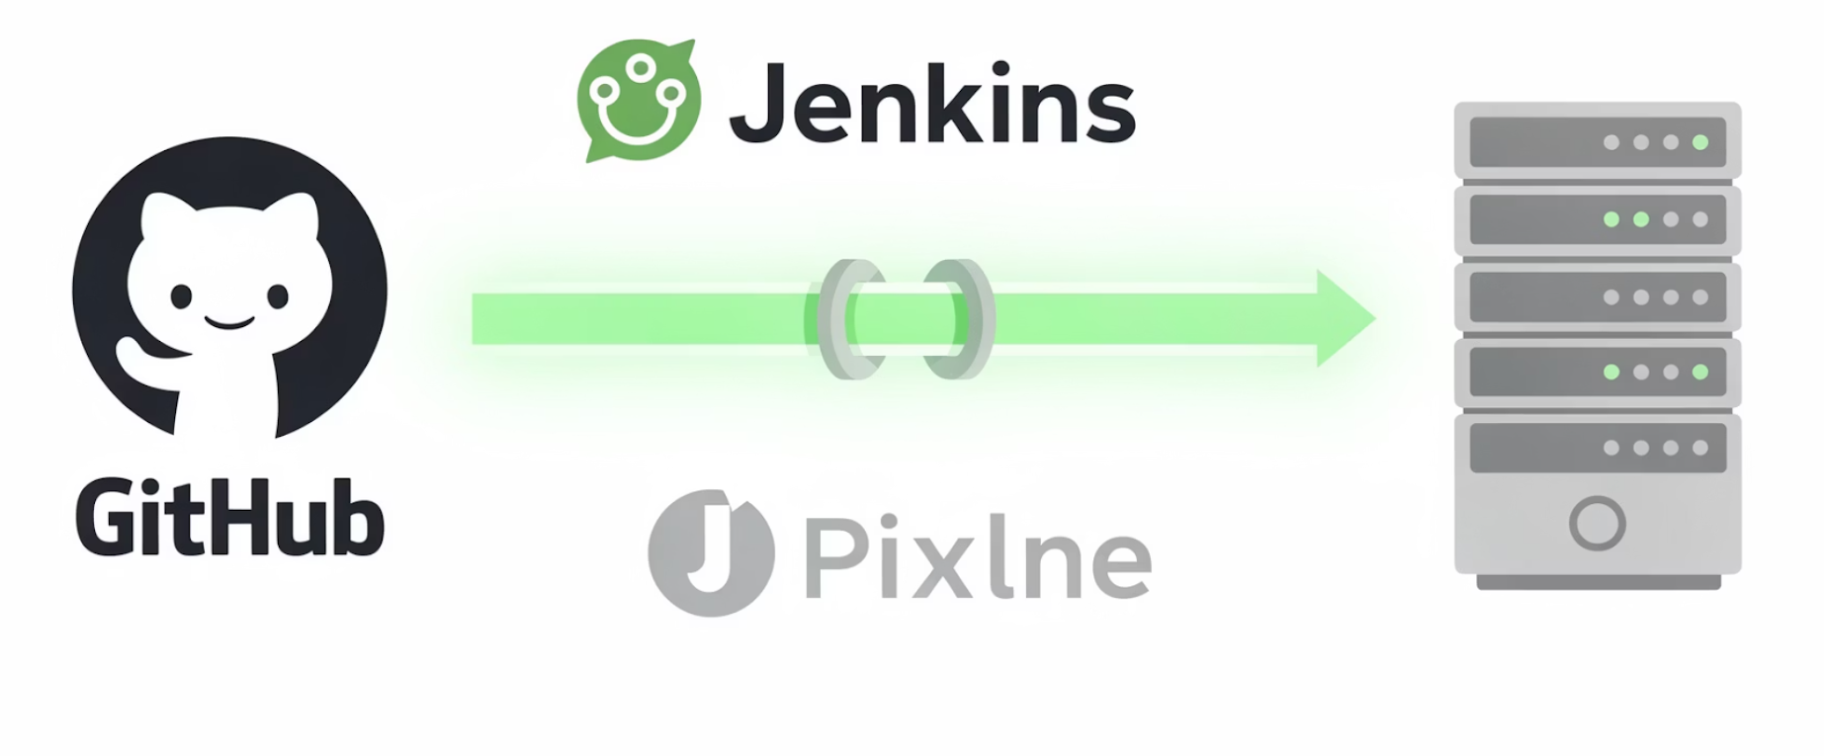
Example Tool Flow
Production server updated automatically.
Developer pushes code to GitHub
01
CI Tool triggers (Jenkins / GitHub Actions)
02
Runs build & automated tests
03
Deploys to production server
19

Slide 20




Automation Mindset
If the task repeats → Automate it.
Daily backup
1
2
Log cleanup
Testing
4
3
Deployment
Automation reduces operational burden.
20

Slide 21
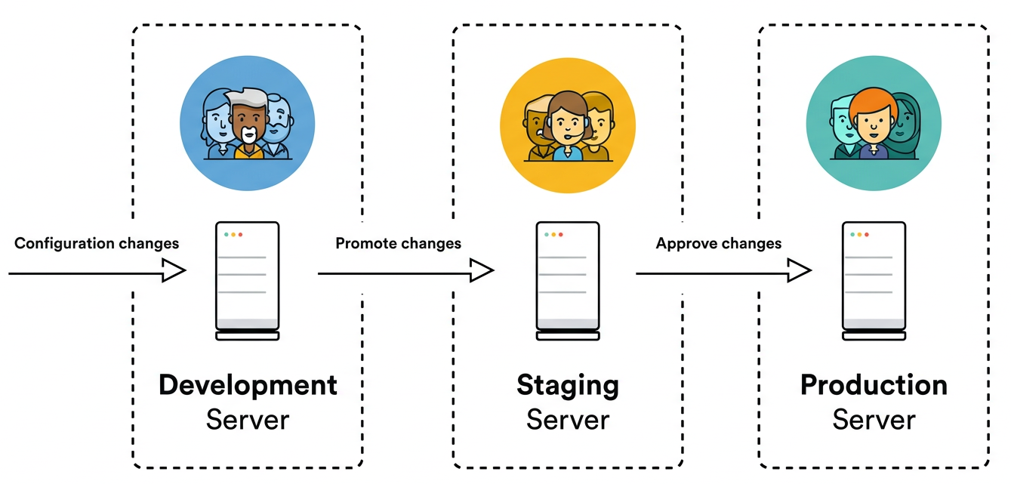
Environment Strategy
Dev → Staging → Production
Typical environments:
Dev → For developers
Staging → Production-like testing
Production → Live users
Why is staging important?
Catch issues before real users
Test real-like configurations
Validate integrations
21

Slide 22
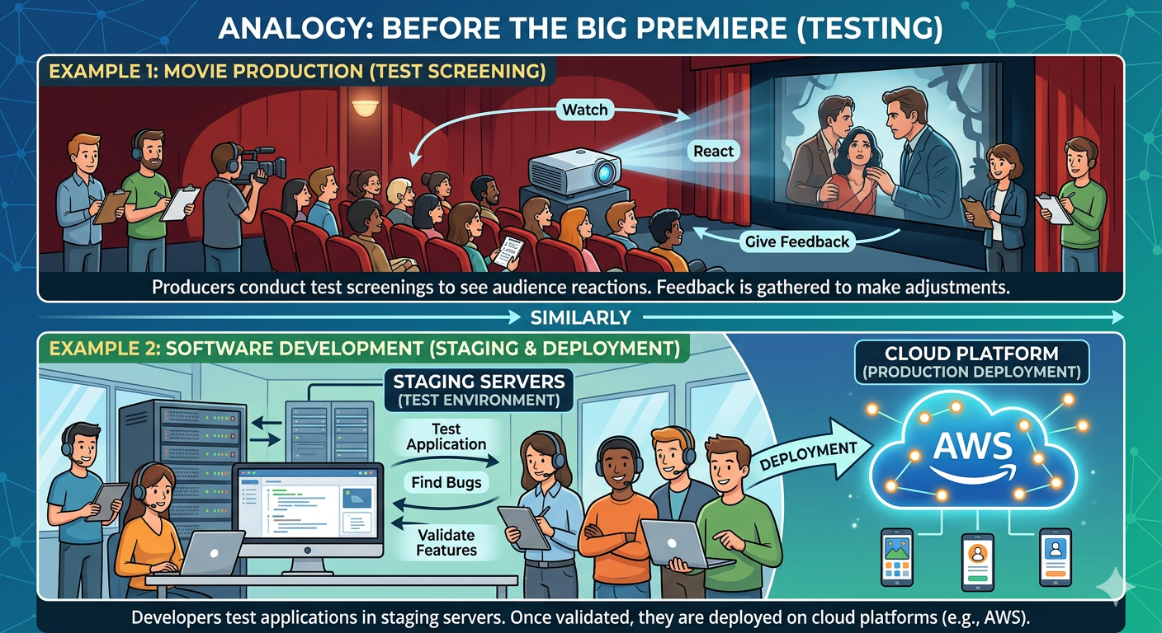
Example of Environment Strategy
Before a new movie releases in theatres, producers conduct test screenings to see audience reactions.
Similarly, developers test applications in staging servers before deploying them on cloud platforms like Amazon Web Services.
22

Slide 23
FAILURE & RECOVERY SCENARIOS
What Happens When Things Fail?
Build Fails
Tests Fail
Deployment Fails
Pipeline stops immediately
Developer notified
Broken code never deployed
Deployment blocked
Developer fixes issue
Pipeline re-run
Rollback to previous version
Blue-Green deployment
Canary release strategy
Benefits:
Benefits:
Benefits:
Broken code never reaches production.
Issues caught early
Automated testing ensures quality.
CI/CD allows safe rollback.
CI/CD allows safe, fast rollback at every stage.
23

Slide 24
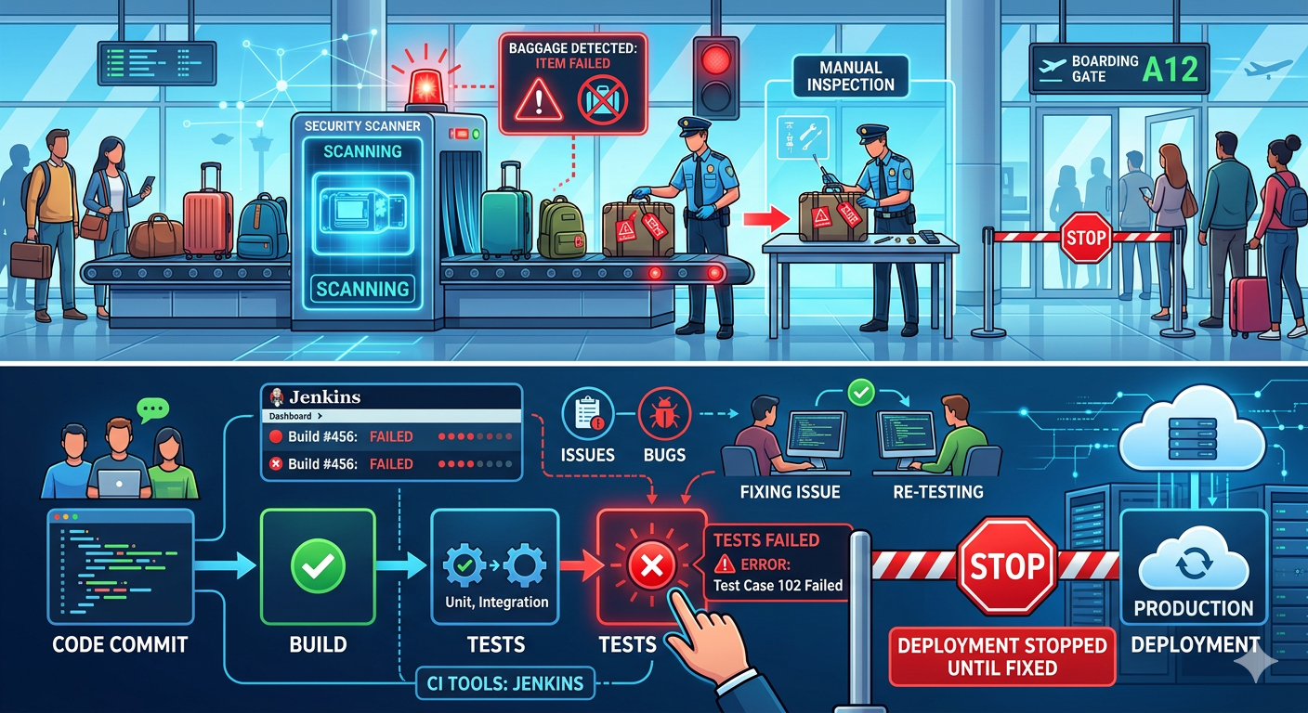
FAILURE & RECOVERY SCENARIOS
Example: If Things Fail?
At an airport security check, if a passenger’s baggage fails the security scan, it is stopped for inspection before boarding.
Similarly, if tests fail in CI tools like Jenkins, deployment stops until the issue is fixed.
24

Slide 25
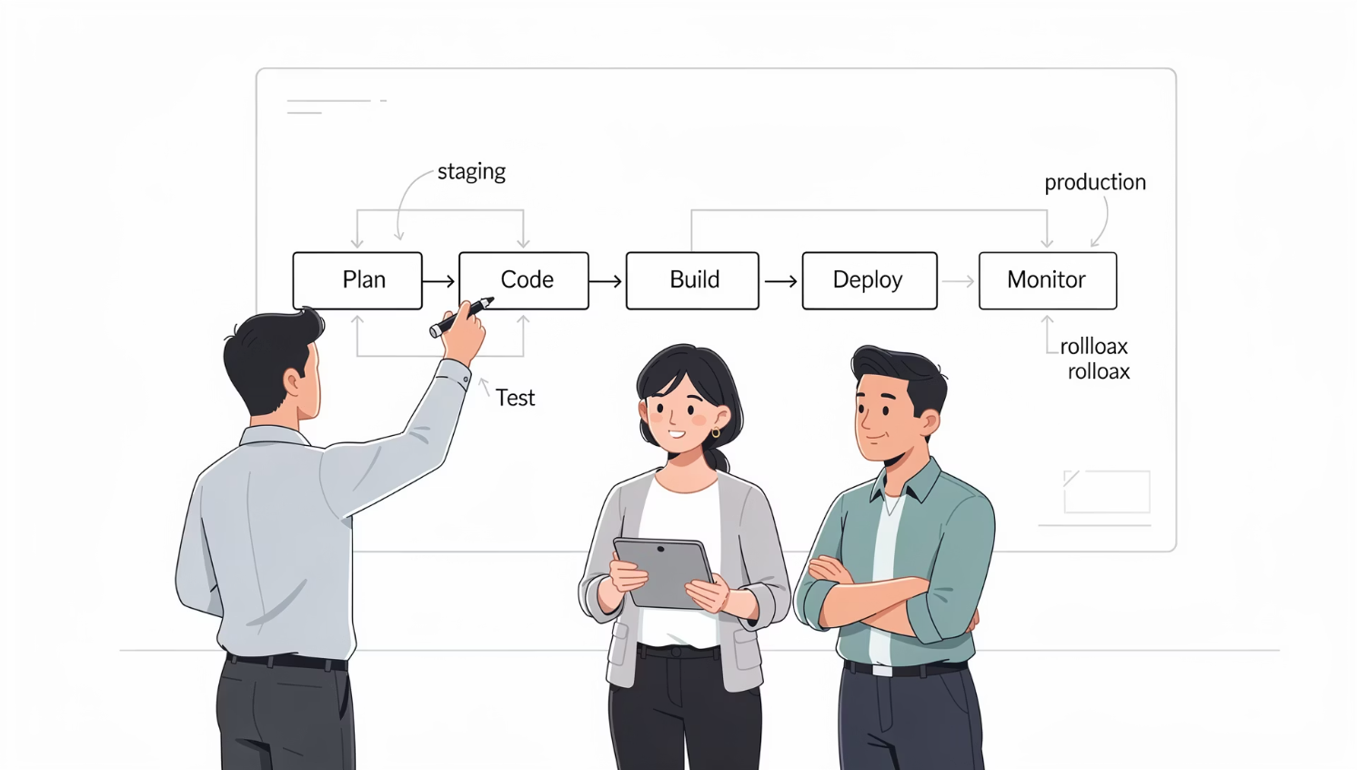
SCENARIO DISCUSSION
Design a Simple Website Pipeline
Scenario: Static website hosted on server
1
Push code to Git
2
Build static files
3
Run tests
4
Deploy to staging
5
Manual approval
6
Deploy to production
25

Slide 26
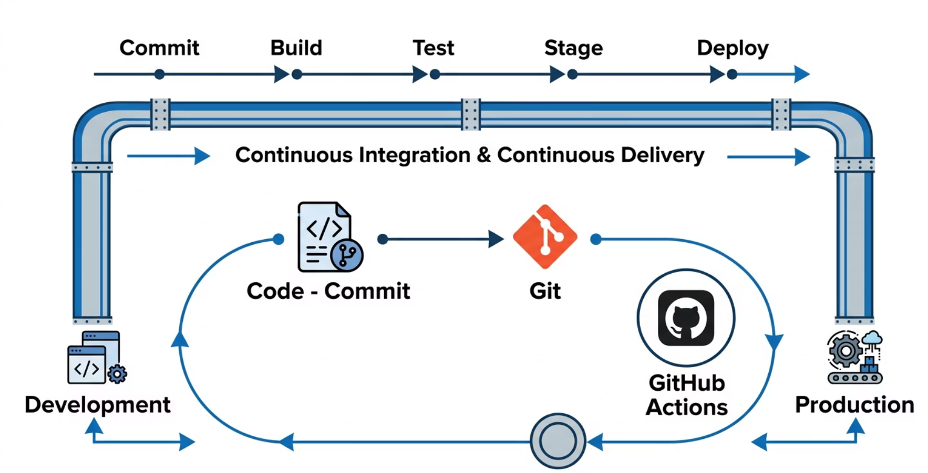




Traffic + Deployment Scenario
Deploying during high traffic — what to consider?
Zero Downtime Deployment
Ensure users experience no interruption
Load Balancer
Distribute traffic during transition
Rolling Update
Gradually replace old instances
Deployment strategy matters as much as the pipeline itself.
26

Slide 27
INTERACTIVE DISCUSSION
Discussion Questions
1
2
3
Can we skip testing in CI?
What if the pipeline is too slow?
Should every commit trigger deployment?
4
5
Is automation expensive initially?
Why is monitoring the last stage?
27

Slide 28
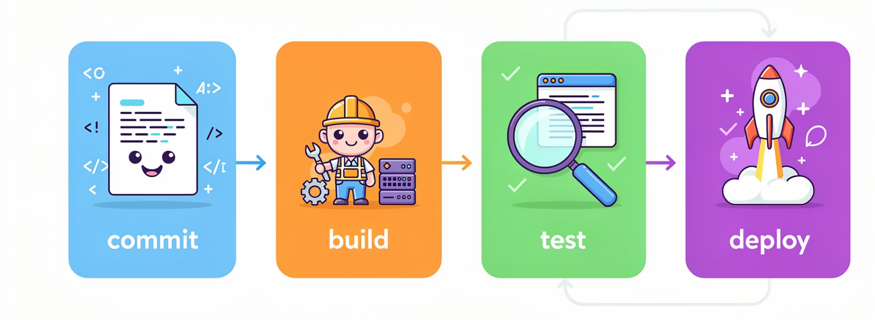

CI/CD Best Practices
Best practices include:
Small frequent commits
Automated testing required
Fail fast (stop pipeline early)
Versioned artifacts
Rollback capability
Pipeline visibility (dashboard)
Key Idea: A pipeline should be reliable and predictable.
28

Slide 29





Common CI/CD Mistakes
Which mistake is most dangerous?
No automated tests
Deploying directly to production
Storing secrets in pipeline config
Not monitoring deployments
Very slow pipeline (developers stop using it)
29

Slide 30






SUMMARY
Key Takeaways
SDLC Overview
Automation
Systematic stages from requirements to maintenance
Foundation of DevOps — speed, consistency, reliability
CI vs CD
Pipeline Stages
CI = quality; CD = speed
Code → Build → Test → Deploy → Monitor
Failure Handling
Pipeline Design
Rollback, Blue-Green, Canary strategies
Tailor pipelines to your deployment context
30

Slide 31


Thank You
25

